Slide 1

KALERWE
S.D.A Hymnal
3 ~ Verses
153.
Kye Ndowoza Kyokka.…
~
One Sweetly Solemn Thought…

Slide 2
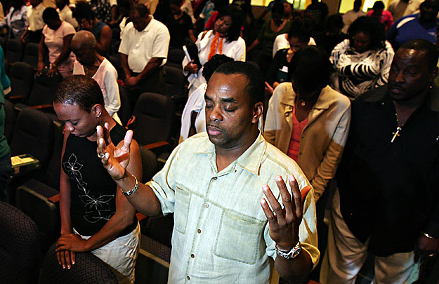
1 of 3 verses
Kye ndowoza kyokka,
Ge maka mu ggulu,
Neyongedde okusembera nateer(a) okutuka

Slide 3
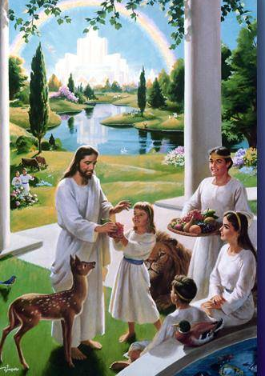
1 of 3 verses
Chorus:
Ndi kumpi n-’amaka gaffe,
Kumpi nnyo,
ku-mpi nnyo leero
Nnaatera okutuuka

Slide 4
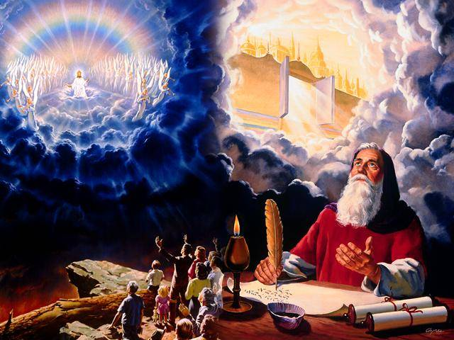
2 of 3 verses
Nsemberedd(e) ewaffe Mu mayumba amangi Eyo Yesu gy’afugira,
Ku nnya-nja ennungi

Slide 5
2 of 3 verses
Chorus:
Ndi kumpi n-’amaka gaffe,
Kumpi nnyo,
ku-mpi nnyo leero
Nnaatera okutuuka

Slide 6
3 of 3 verses
Bwe ndituuka eyo, Nyetikkula byonna,
Ennaku ndi- gyerabira, Ndyamba-la engule

Slide 7
3 of 3 verses
Chorus:
Ndi kumpi n-’amaka gaffe,
Kumpi nnyo,
ku-mpi nnyo leero
Nnaatera okutuuka

